Slide 1
LAYOFFS & ECONOMIC FACTORS
Presented by
Sai Manigopal Reddy Kanumathireddy

Slide 2
TABLE OF CONTENTS
Introduction
Data Sources
Data Preprocessing
Data Visualization & Insights
Conclusion
Future Scope
Q&A

Slide 3
INTRODUCTION
INTRODUCTION
The global economy constantly undergoes fluctuations influenced by various factors such as inflation, government policies, and market trends. These fluctuations often have a profound impact on businesses, leading to changes in workforce dynamics, including layoffs.
This project focuses on analyzing the relationship between key economic indicators and workforce layoffs, aiming to uncover insights that provide a deeper understanding of these trends.
OBJECTIVE
To explore patterns and relationships between economic indicators (e.g., inflation, GDP) and workforce layoffs.
SIGNIFICANCE
Understanding how economic shifts influence layoffs and workforce stability.
Identifying industries most affected by economic downturns.
Offering actionable insights for businesses and policymakers.

Slide 4
DATA SOURCES
LAYOFFS DATA
Description: Details layoffs across various companies, including information on industries, company stages, layoff percentages, and locations.
Timeframe: Includes layoffs data from March 2020 to May 2024.
Source: Layoffs
ECONOMIC DATA
Description: Contains monthly data on key economic indicators such as inflation rates, GDP, federal funds rate, consumer confidence index, and retail sales.
Timeframe: March 2020 to May 2024.
Source: US Inflation Rate, CPI Value, Fed Interest Rate, GDP, Stock Prices, GSCPI

Slide 5
DATA PREPROCESSING
Data Loading: Importing layoffs and economic datasets.
Standardization: Removing leading and trailing spaces, and handling name inconsistencies.
Data Type Conversion: Ensuring correct data types for seamless processing.
Handling Missing Values: Removing or imputing null values to ensure data completeness.
Data Reduction: Filtering relevant rows and columns for focused analysis.
Data Transformation: Aggregating, normalizing, and enriching data for deeper insights.
Data Merging: Integrating layoffs and economic datasets for a consolidated view.

Slide 6
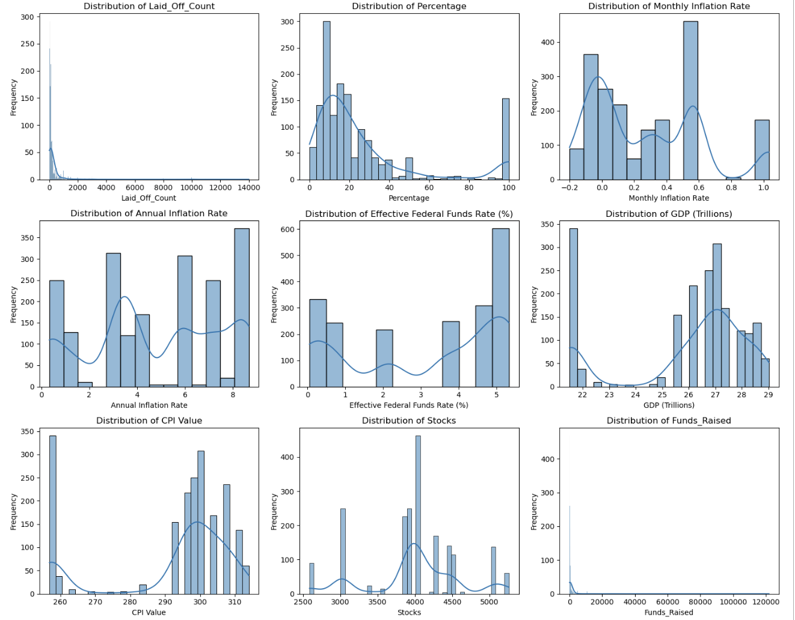
DATA VISUALIZATION
Layoffs and Fundraising Disparities: The distribution of layoffs (# Laid Off) and funds raised highlights significant skewness, with a majority of companies experiencing smaller layoffs or raising limited funds, while a few outliers dominate the higher end.
Federal Funds Rate Trends: The Federal Funds Rate shows a bimodal distribution, with values concentrated near 0% (reflecting economic stimulus periods) and another peak around 4-5% (indicative of monetary tightening to control inflation).
Economic Indicators Stability: Distributions for GDP and CPI values exhibit consistent clustering, showing a relatively stable economic growth trend and consumer price index over time.
Inflation Variability: Both monthly and annual inflation rates display multimodal patterns, suggesting fluctuations between inflationary and deflationary pressures during the analyzed period.

Slide 7
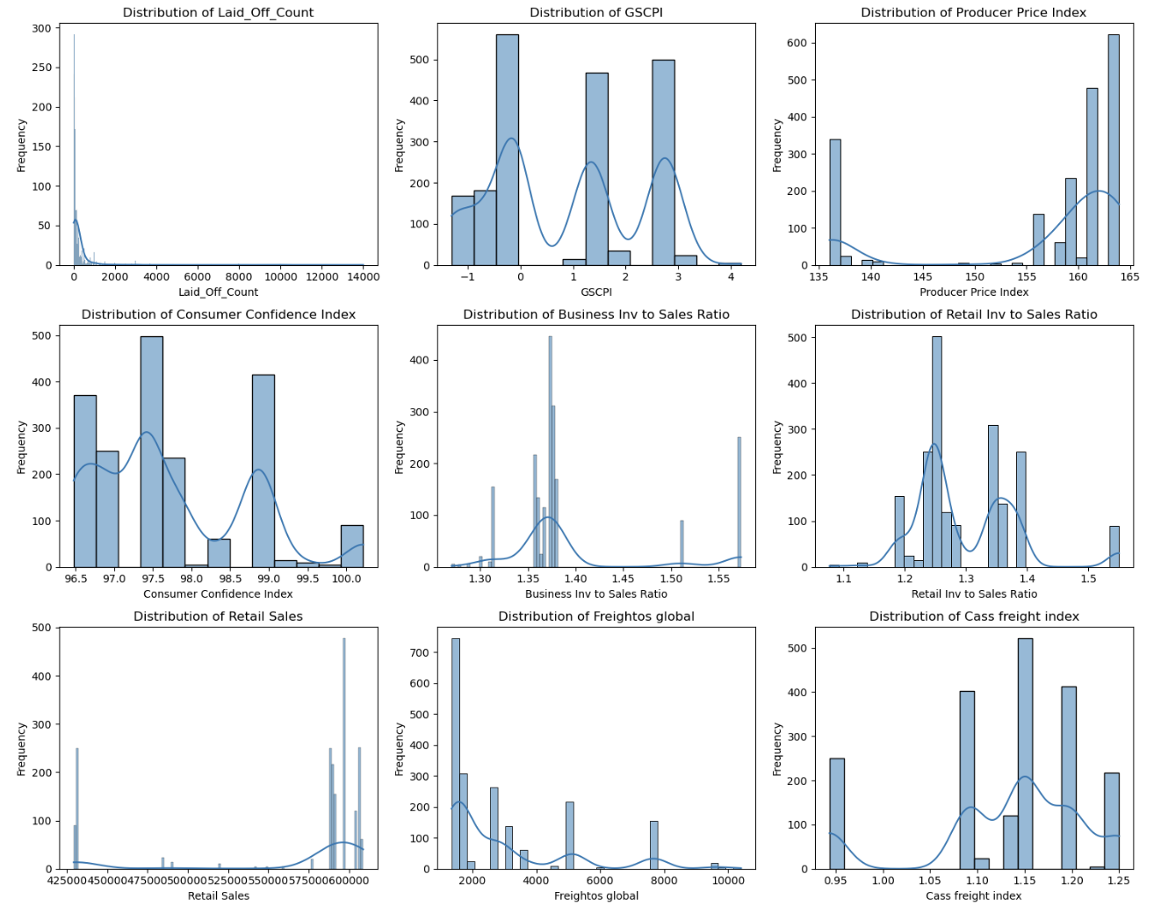
DATA VISUALIZATION
GSCPI (Global Supply Chain Pressure Index): The GSCPI distribution has distinct peaks around 1.5 and 3.0, indicating varying levels of supply chain pressure, with moderate-to-high stress dominating the observed period.
Producer Price Index (PPI): The distribution of the Producer Price Index shows a sharp peak between 160-165, suggesting that most producer prices have stabilized at higher levels during the analyzed timeframe, possibly reflecting inflationary trends.
Retail Inventory to Sales Ratio: Concentrated between 1.2 and 1.4, indicating consistent inventory management in retail sectors.
Business Inventory to Sales Ratio: Clusters around 1.3-1.4, showcasing steady business practices in managing stock relative to sales.
Freightos Global Index: Right-skewed, with most values under 3,000, but occasional spikes beyond 10,000 indicate disruptions or periods of high demand.
Cass Freight Index: Centered around 1.0-1.2, showing relatively stable freight activity with occasional peaks.

Slide 8
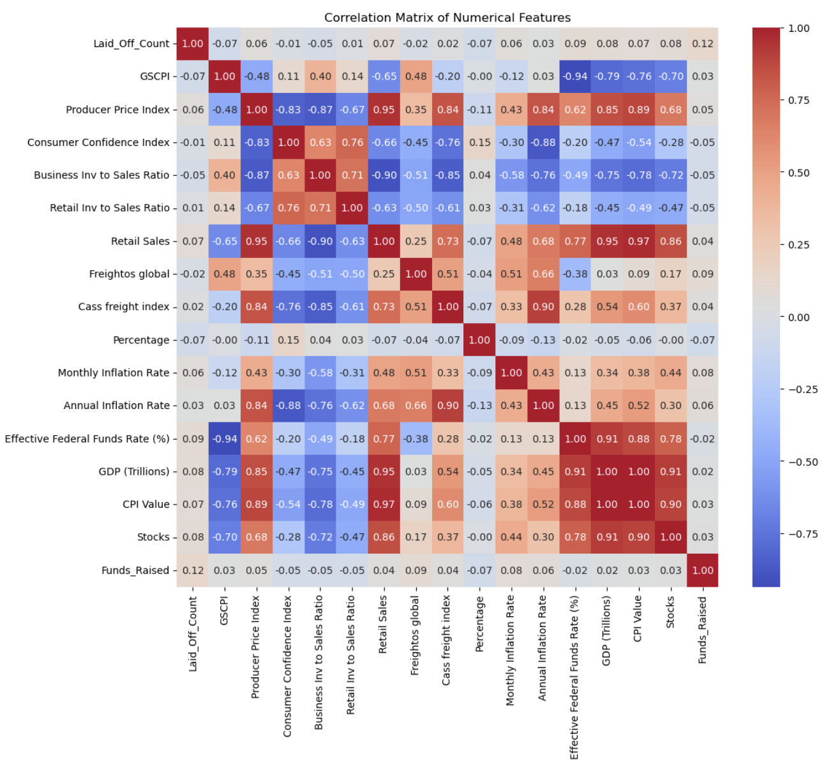
DATA VISUALIZATION
GDP, CPI Value, and Stocks show very strong positive correlations with each other (all around 0.90-1.00), suggesting these economic indicators tend to move together very closely in the same direction.
The Consumer Confidence Index has strong negative correlations with both Producer Price Index (-0.83) and Annual Inflation Rate (-0.88), indicating that consumer confidence tends to decrease when prices and inflation rise.
Laid_Off_Count shows surprisingly weak correlations with most other variables (correlation values near 0), suggesting that layoffs might be more influenced by company-specific factors rather than broader economic indicators.
GSCPI (Global Supply Chain Pressure Index) has a very strong negative correlation with the Effective Federal Funds Rate (-0.94), suggesting that as interest rates increase, supply chain pressures tend to decrease significantly, or vice versa.

Slide 9
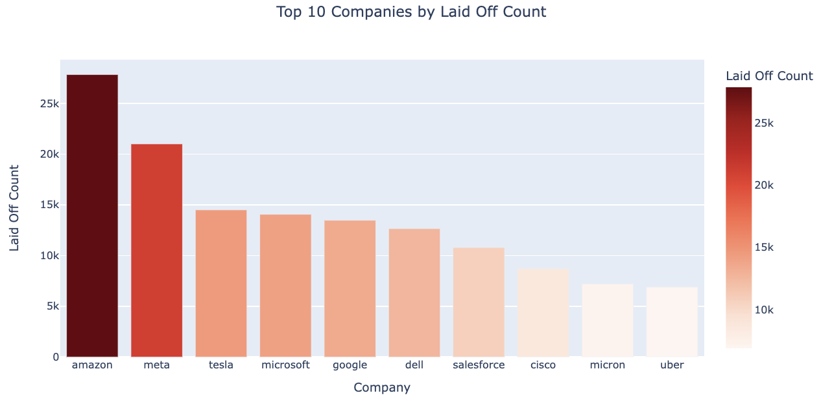
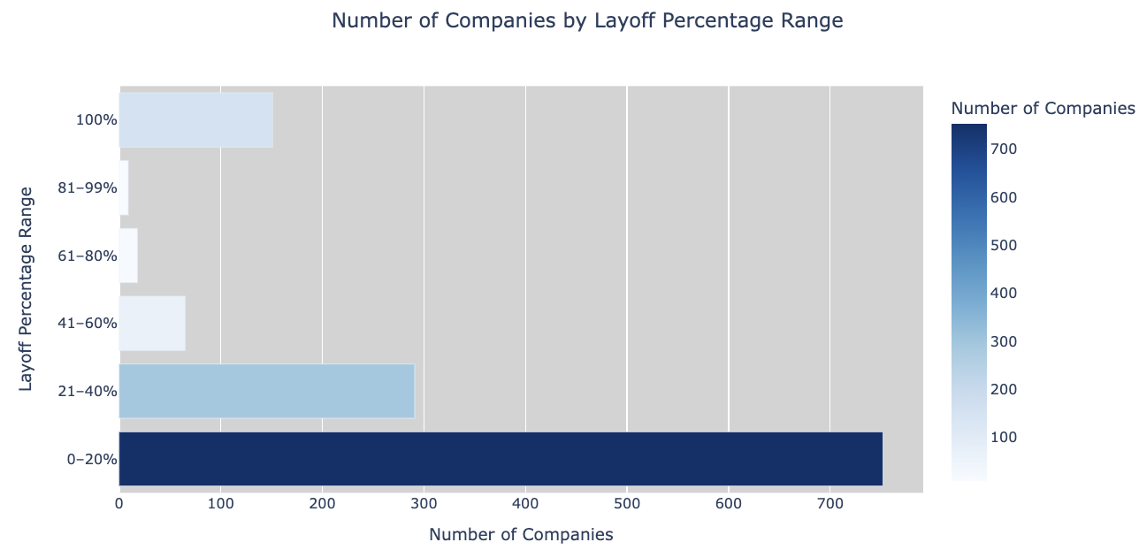
DATA VISUALIZATION
Amazon and Meta dominate layoffs with counts exceeding 20,000, significantly higher than other companies, highlighting their major role in recent workforce reductions.
Layoffs are highly concentrated in a few top companies, with others having relatively lower counts.
The majority of companies (700+) fall in the 0–20% layoff range, suggesting that most layoffs are partial rather than entire workforce reductions.
Layoffs are concentrated around 0-40% range and at 100%

Slide 10
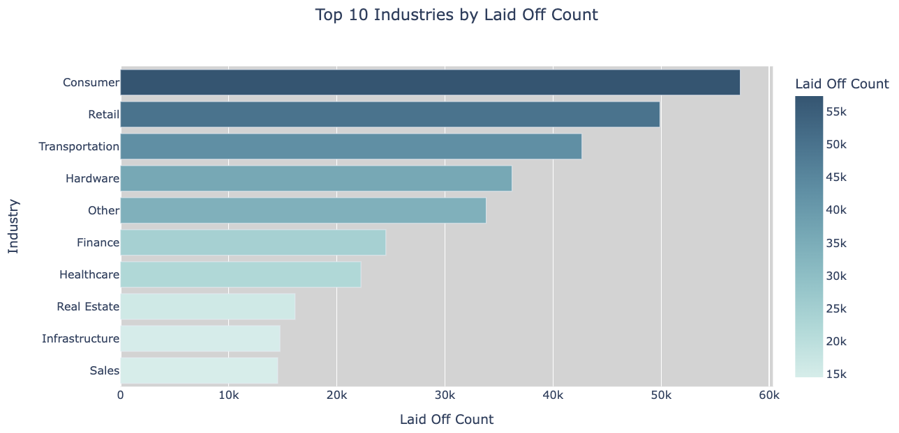
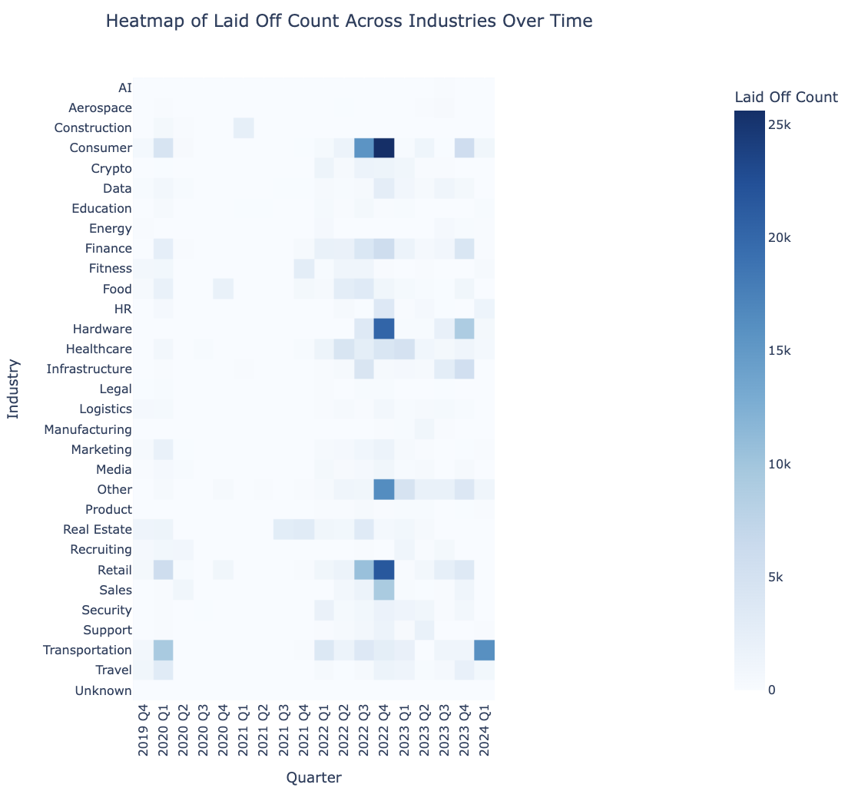
DATA VISUALIZATION
The consumer industry has the highest number of layoffs, exceeding 55,000, highlighting its vulnerability to economic downturns or shifting market conditions.
Retail and transportation industries also show significant layoffs, indicating potential supply chain issues or reduced consumer demand affecting these sectors.
The consumer and retail industries exhibit significant layoffs during specific quarters, such as late 2022 and early 2023, reflecting major disruptions or economic downturns impacting these sectors.
Layoffs are not evenly distributed over time; certain industries like technology, logistics, and finance show spikes in layoffs during specific quarters.

Slide 11
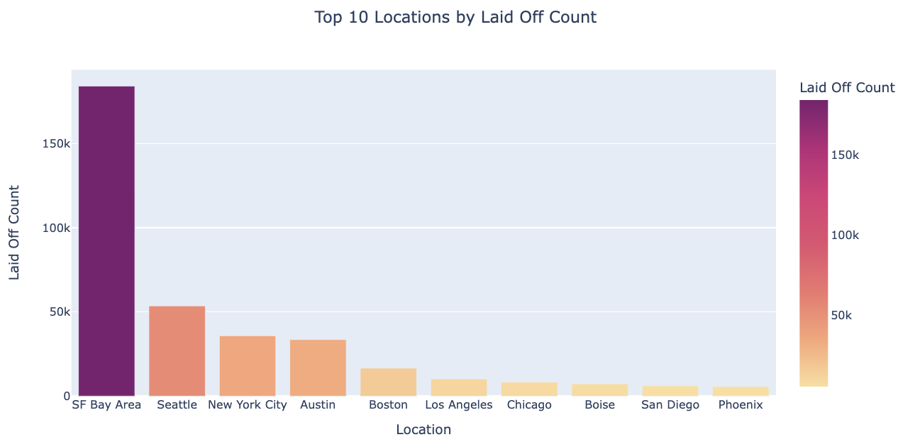
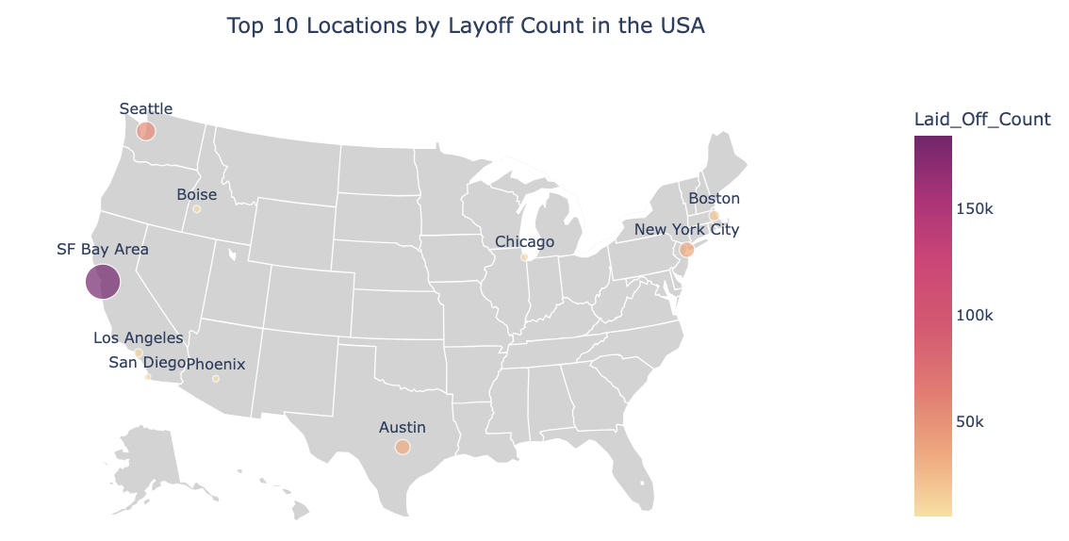
DATA VISUALIZATION
The SF Bay Area leads with over 150,000 layoffs, significantly outpacing other locations, reflecting its high concentration of technology companies heavily impacted by workforce reductions.
Locations like Seattle, New York City, and Austin follow with moderate layoffs, showcasing the broader geographical distribution of workforce reductions in major urban hubs.
The map highlights a concentration of layoffs in coastal and tech-heavy cities, such as the SF Bay Area, Seattle, and New York City, with fewer layoffs occurring in inland cities.
This visualization provides a clear spatial understanding of where layoffs are most concentrated, helping to contextualize the bar chart data geographically.

Slide 12
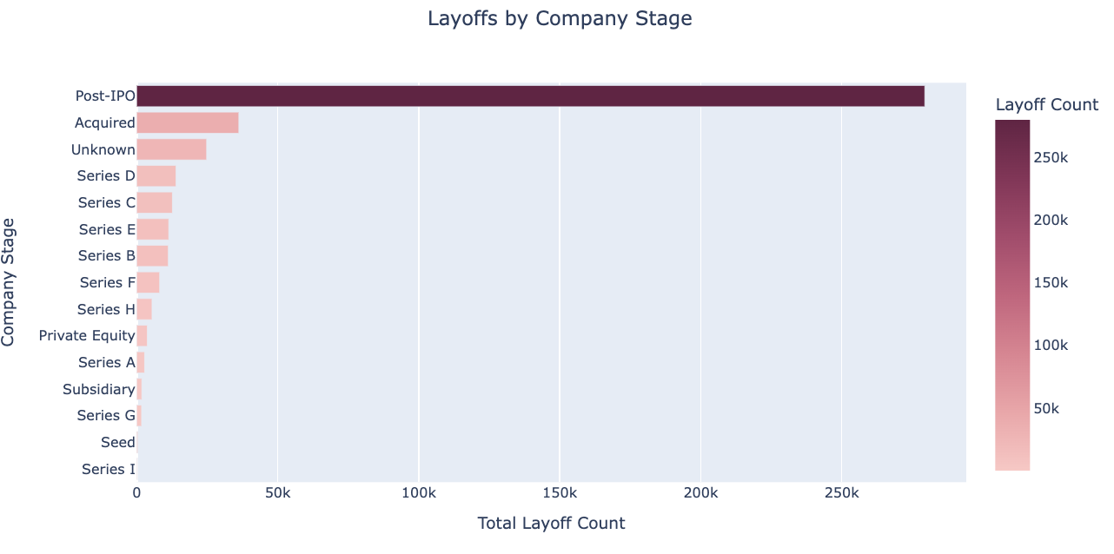
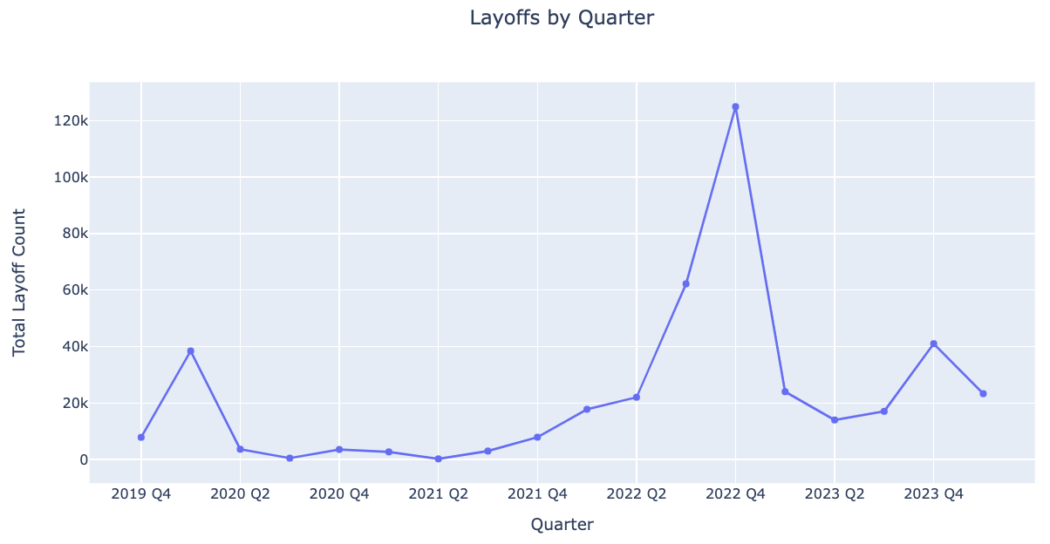
DATA VISUALIZATION
Post-IPO companies have the highest layoffs by a substantial margin, indicating that mature firms are making significant workforce adjustments to address market pressures.
Companies in earlier funding stages, such as Series A or Seed, show significantly fewer layoffs, likely reflecting their smaller workforce sizes and early-stage growth focus.
There is a sharp rise in layoffs in Q4 2022, peaking above 120,000, which may correspond to economic downturns or industry-wide restructuring during that period.
Layoff counts show notable fluctuation over time, with periods of low activity followed by sudden spikes, reflecting external factors like economic conditions or sector-specific challenges.

Slide 13
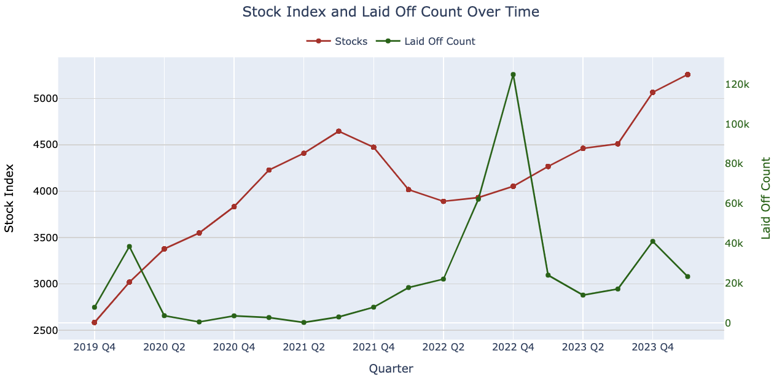
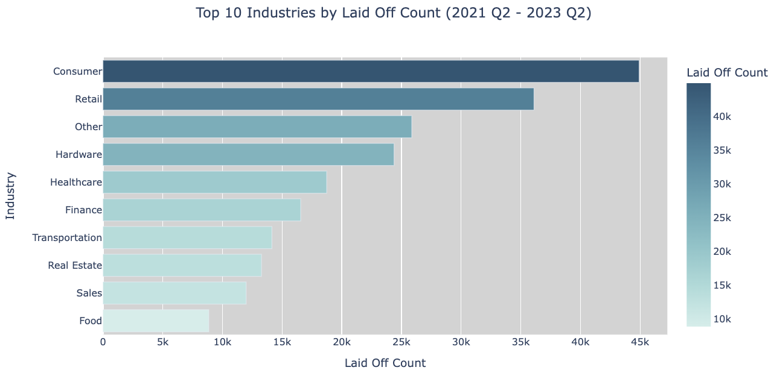
DATA VISUALIZATION
The highest layoff count in Q4 2022 aligns with a decline in the stock index, indicating a possible link between market downturns and workforce reductions as companies cut costs to stabilize.
In 2023, as the stock index steadily recovers, layoffs decrease significantly after their Q4 2022 peak, suggesting improving market conditions and potentially more stable employment environments.
The consumer and retail industries have the highest layoffs, with consumer layoffs exceeding 45,000, reflecting significant impacts from changing economic conditions and consumer behavior during this period.
Other industries, including hardware, healthcare, and finance, also experienced considerable layoffs, indicating that workforce reductions were not limited to a specific sector but spread across multiple industries.

Slide 14
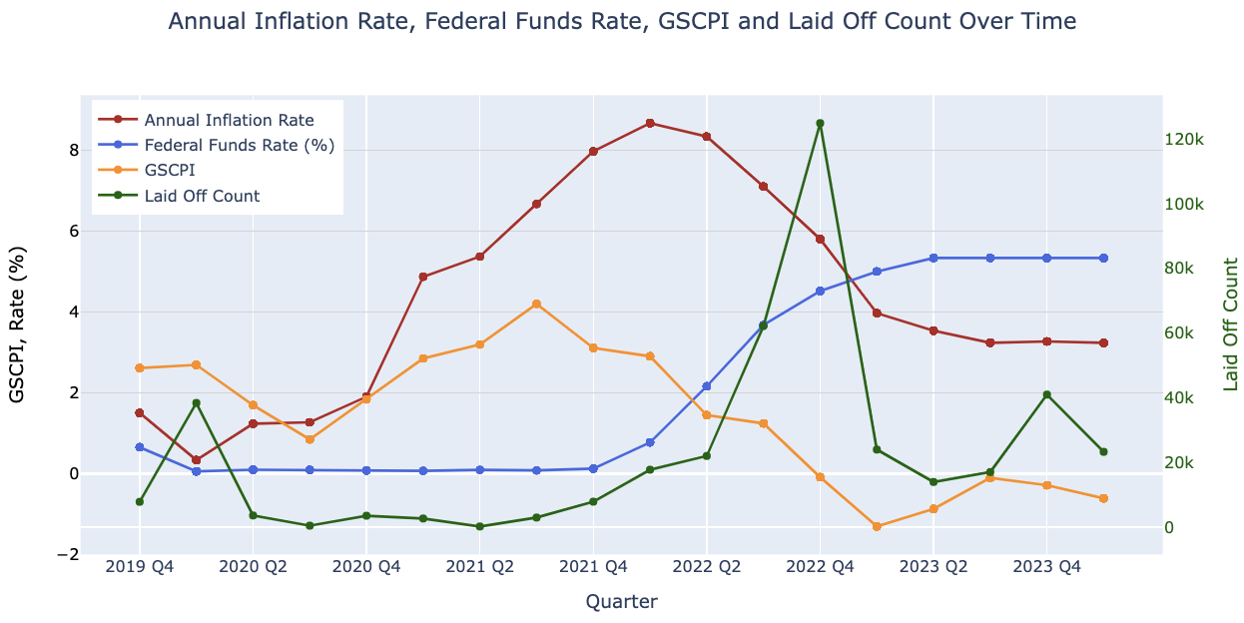
DATA VISUALIZATION
The Federal Funds Rate hikes lag behind inflation, showing that the Federal Reserve acted in response to rising inflationary pressures.
The spike in layoffs around 2022 Q4 aligns with the period of high inflation and rising interest rates, suggesting economic contraction and cost-cutting measures by companies.
Supply chain pressures (GSCPI) played a role in the earlier phase of inflation but subsided before the inflation peak, indicating that inflation became more demand-driven later.
The interplay between these factors highlights the complex dynamics between monetary policy, inflation, supply chain conditions, and employment.

Slide 15
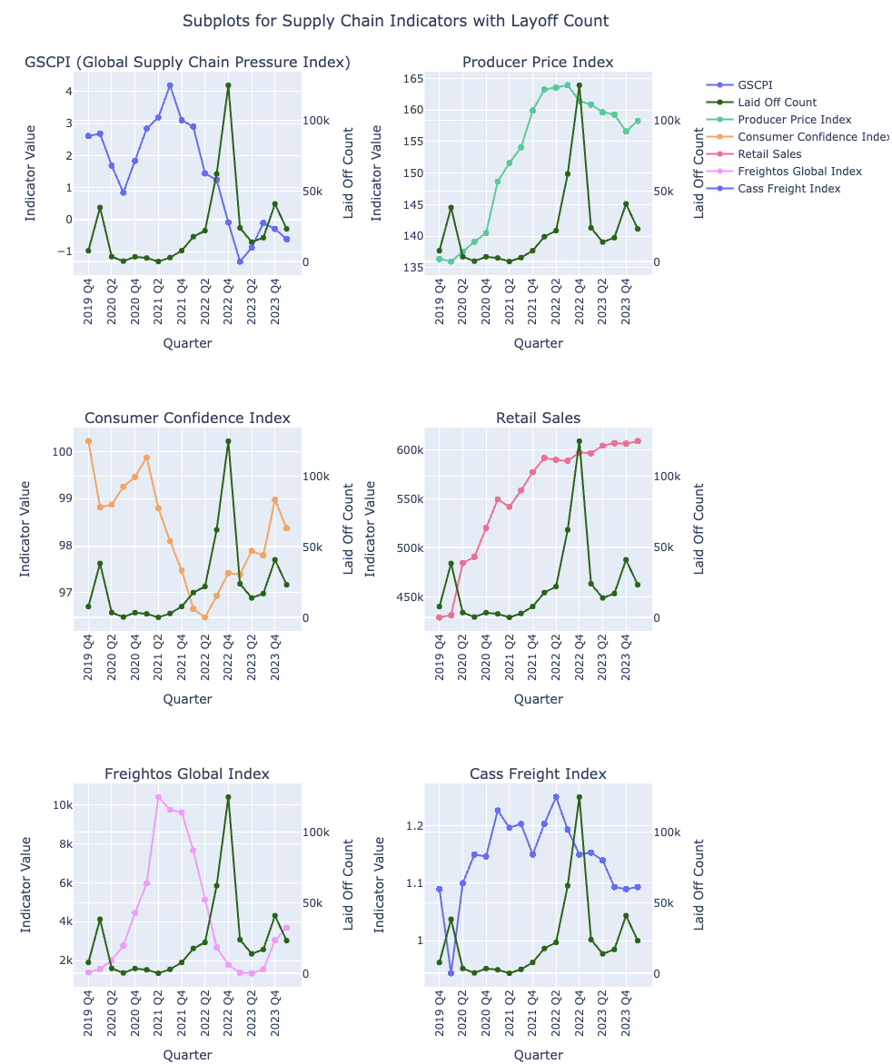
DATA VISUALIZATION
The Global Supply Chain Pressure Index (GSCP) shows a peak in Q4 2021, which is followed by a sharp rise in layoffs in 2022, indicating that supply chain stress may have contributed to workforce reductions.
The Consumer Confidence Index and Retail Sales show contrasting trends during the analyzed period; as layoffs peak, consumer confidence sharply declines, reflecting reduced economic optimism, while retail sales remain relatively stable, indicating resilience in consumer spending despite workforce reductions.
The Producer Price Index remains elevated during peak layoffs in 2022, highlighting that increased production costs may have strained business operations, contributing to workforce reductions.
Both Freightos Global and Cass Freight Indices display fluctuations aligned with GSCP, reflecting broader supply chain disruptions and their potential role in layoffs across industries.

Slide 16
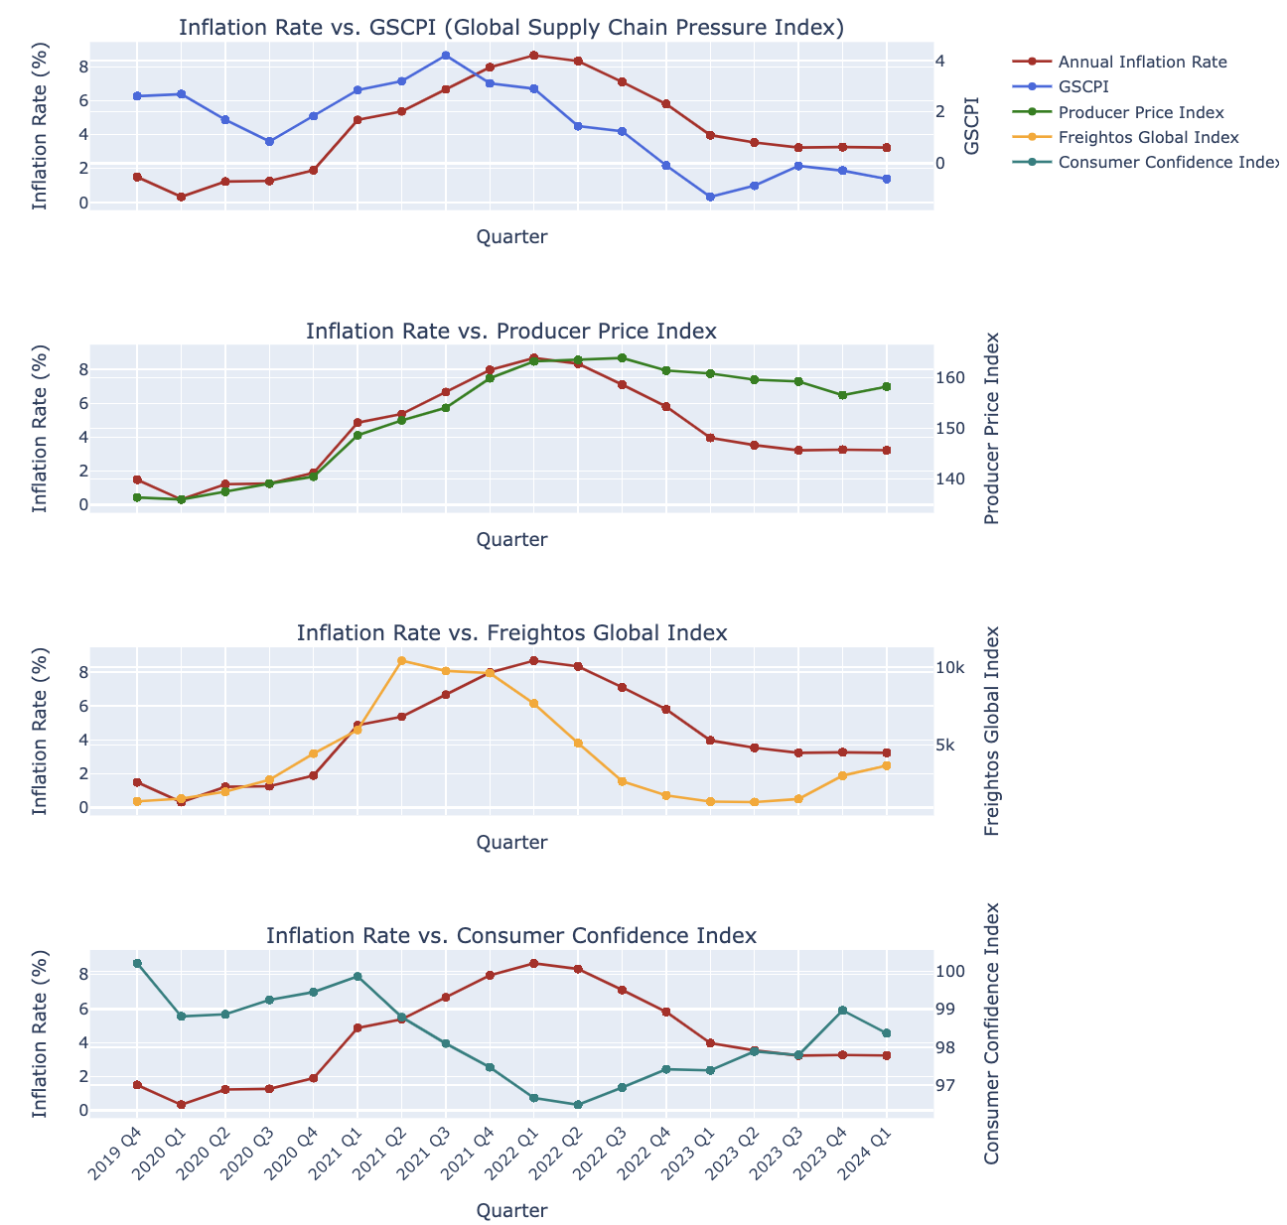
DATA VISUALIZATION
The GSCP peaks in Q4 2021 as inflation rises sharply, indicating that supply chain disruptions may have played a significant role in fueling inflation during this period.
A strong positive correlation is evident between inflation and the PPI, as both peak around the same time (2022). This suggests that rising production costs directly contribute to inflationary pressures.
The Freightos Global Index rises during 2021 and declines as inflation stabilizes post-2022. This indicates that logistics costs may also have contributed to inflationary trends before supply chains eased.
Inflation negatively correlates with consumer confidence. As inflation peaks in 2022, consumer confidence dips, reflecting the adverse impact of rising prices on consumer sentiment and spending behavior.

Slide 17
CONCLUSION
The period from 2020 to 2023 was marked by significant economic fluctuations, driven by rising inflation, monetary tightening, and supply chain disruptions. Inflation surged to record highs by 2022, prompting the Federal Reserve to hike interest rates sharply. This monetary tightening, while necessary to combat inflation, created ripple effects across industries, leading to widespread layoffs.
Supply chain disruptions, as evidenced by the peaks in the Global Supply Chain Pressure Index (GSCPI), played a critical role in the earlier phases of inflation and workforce reductions. Freight indices, including Freightos Global and Cass Freight, also showed significant fluctuations, pointing to logistical challenges that impacted operational efficiency and costs.

Slide 18
FUTURE SCOPE
Utilize predictive modeling techniques to forecast future layoff trends based on economic and supply chain indicators.
Conduct in-depth, industry-specific studies to understand the unique impacts of global events or economic policies on various sectors.
Extend the timeline of the analysis to include pre-2019 and future datasets, uncovering long-term patterns and cyclical trends.

Slide 19
REFERENCES
https://medium.com/@biondi.jeffrey/global-layoffs-impact-on-companies-data-cleaning-analysis-using-mysql-and-tableau-1191536cc136
https://www.kaggle.com/code/maxboonjindasup/2024-layoffs-cleaned-data-analysis#2020---2024-Workforce-Layoff-Analysis

Slide 20
Q&A

Slide 21
THANK YOU

